Slide 1

WILD PLANTS EDIBILITY PREDICTION USING IBM WATSON STUDIO
PRESENTED BY:
A.SATHVIKA
B.NS MANI CHANDRIKA
B.SACHIN
B.BHARGAV REDDY
CH.TULASI

Slide 2

INDEX :
1.INTRODUCTION
2.PURPOSE
3.TRAINING AND MACHINE
4.TESTING
5.APPLICATIONS
6.ADVANTAGES AND DISADVANTAGES
7.CONCLUSION

Slide 3

INTRODUCTION :
The consumption of wild edible plants is an ancient phenomenon which predates agriculture . These plants offer various benefits and opportunities to communities; for example, they enable communities to cope with food scarcity . This is also known as ecosystem-based adaptation . They hold great cultural significance to dependent communities . In addition, wild edible plants increase the nutritional quality of rural diets for instance, micronutrients (vitamins and minerals) which are sometimes superior to those of domesticated varieties . Some of them also contain genes that can be sought to improve the productivity of cultivars .

Slide 4
The selection of plants for ethnobotanical use is anchored in a theory. The theories include among others the optimal foraging theory and theory of non-random plant selection . The former predicts that foraging organisms will balance the effort it took to search for and eat that food. In so doing, individuals will place high value on plants that yield more benefit per unit of foraging/processing time; as abundance of plants with higher value increases, plants with lower value will no longer be used and individuals should have a quantitative threshold to decide when a specific plant should be included or excluded.

Slide 5
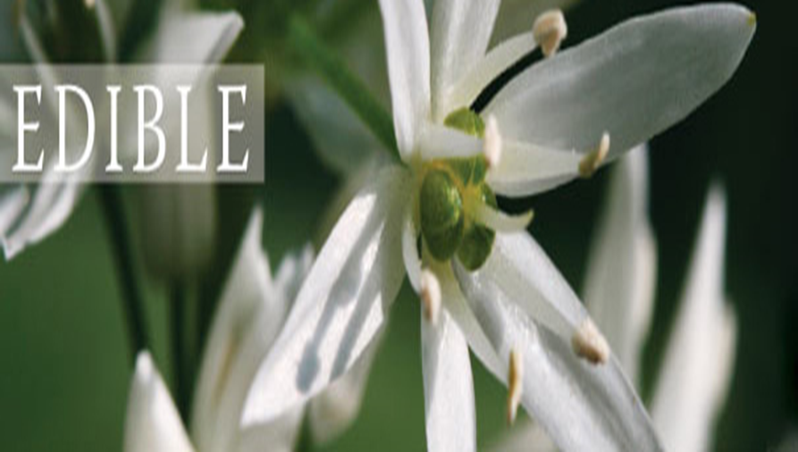
PURPOSE :
There are over 20,000 species of edible plants in the world yet fewer than 20 species now provide 90% of our food. However, there are hundreds of less well known edible plants from all around the world which are both delicious and nutritious.

Slide 6
TRAINING AND MACHINE :
1.We have used Python which is a statistical mathematical programming language like R instead of MATLAB.
2.Import image Data generator and configure it.
3.Apply image Data generator functionality to train and test set.
4.Import required model building.
5.libraries initialize the model, add convolution layers, pooling layer, flatten layer and dense layer.
6.Compile the model fit and save the model.

Slide 7
TESTING :
1.The model is tested and saved to do predictions.
2.Load model is used to load our saved model h5file.
3.Taking an image as input and checking the results.
4.By using the model we are predicting the output for the given input image.
5.The predicted class index name will be printed.

Slide 8
APPLICATIONS :
1.The main application of this model is to predict the provided image of wild plant is edible or not. It is well trained so that it will predict the correct data.
2.we will be building a web application that is integrated to the model we built.
3.DA UI is provided for the uses where he has uploads an image. The uploaded image is given to the saved mode. 4.prediction is showcased on the UI.

Slide 9
ADVANTAGES AND DISADVANTAGES
ADVANTAGES :
1.Suitable for species with recalcitrant and intermediate seeds.
2.Convenient for characterization and evaluation.
3.Easily accessible for use.
4.Allow for conservation of particular genotypes.
5.Possible to combine conservation and research/observation.

Slide 10
DISADVANTAGES :
1.Vulnerable to changes in management practices Susceptible to pests, diseases, and other natural and/or human-driven calamities such as drought, neglect, andwar.
2.Limited amount of genetic diversity conserved.
3.High maintenance costs.
4.Not suitable for long-term conservation.

Slide 11
CONCLUSION :
While using the machine learning algorithms in connection with images captured by satellites and drones, Al-enabled technologies predict weather conditions, analyze crop sustainability and evaluate farms for the presence of diseases or pests and poor plant nutrition on farms with data like temperature, precipitation.

Slide 12
THANK YOU

